Slide 1
Distance and Length
Topic: Distance and Length
EQ: How can we apply our knowledge of scale ratios to figure out real life distances?

Slide 2
Topic: Distance and Length EQ: How can we apply our knowledge of scale ratios to figure out real life distances?
Learning Objectives:
Understand what a scale tells you
Able to produce a scale drawing
Able to use a scale to read a map

Slide 3
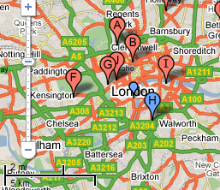

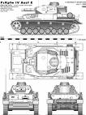
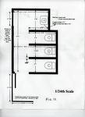
What are scale drawings?
Scale drawings are everywhere!
Scale Drawings
Vehicle design
On Maps
Footprints of houses

Slide 4
Topic: Distance and Length EQ: How can we apply our knowledge of scale ratios to figure out real life distances?
Scale drawing allows us to draw large objects on a smaller scale while keeping them accurate. We also do scale drawings of smaller objects and enlarge them in drawings.
All scale drawings must have a scale written on them. Scales are usually expressed as ratios
Example: 1cm : 100cm which can also be written as 1:100
The ratio 1cm:100cm means that for every 1cm on the scale drawing the length will be 100cm in real life

Slide 5
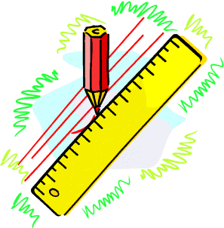
Topic: Distance and Length EQ: How can we apply our knowledge of scale ratios to figure out real life distances?
Example:
A scale of
1 cm = 2m
…means for every 1cm measured on a
drawing this represents 2m in real-life.

Slide 6
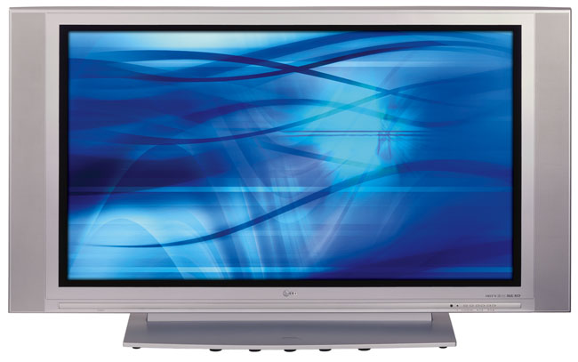
Topic: Distance and Length EQ: How can we apply our knowledge of scale ratios to figure out real life distances?
4x25= 100cm
4cm
2cm
2x25 = 50cm
The scale of this drawing is 1cm = 25cm
What is the actual width and height of the TV ?

Slide 7
Scale Drawings
Scale of 1cm : 9m, what would the triangle in metres look like?
5cm
45m
3cm
27m
4cm
36m

Slide 8
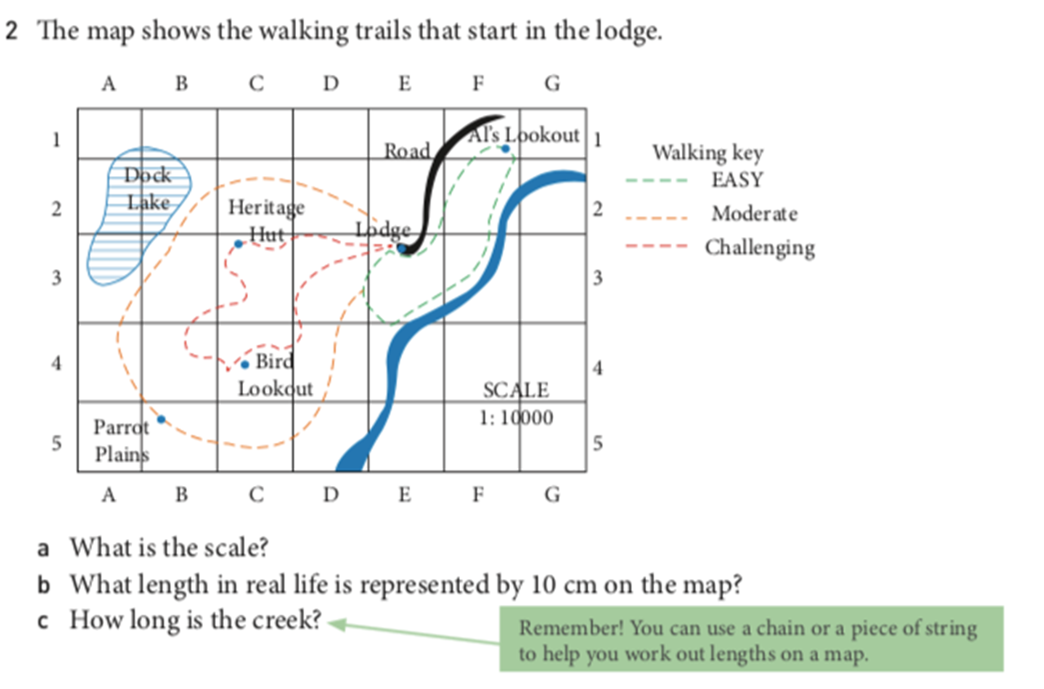

Slide 9
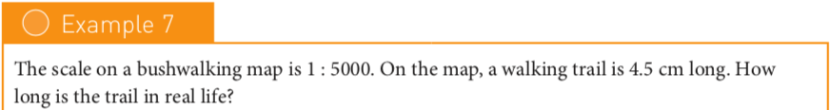
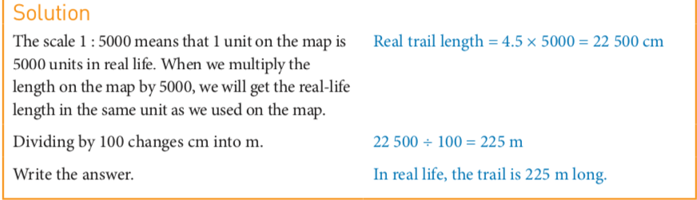
Topic: Distance and Length EQ: How can we apply our knowledge of scale ratios to figure out real life distances?

Slide 10
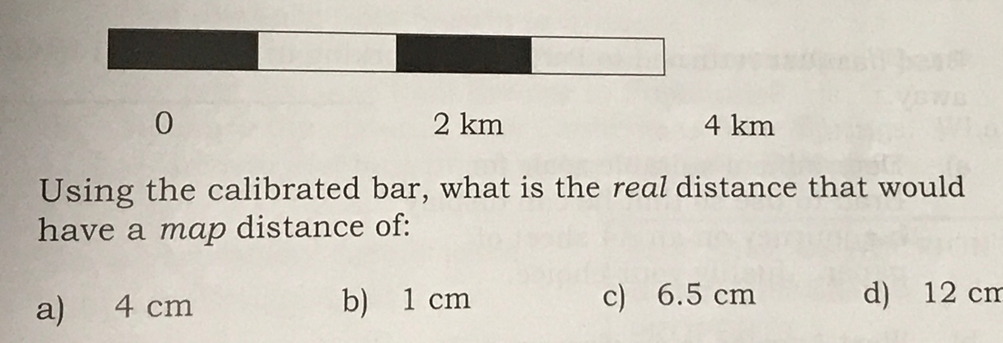
TOPIC: CALCULATING DISTANCES
EQ: HOW DO WE CALCULATE DISTANCES?
8cm

Slide 11
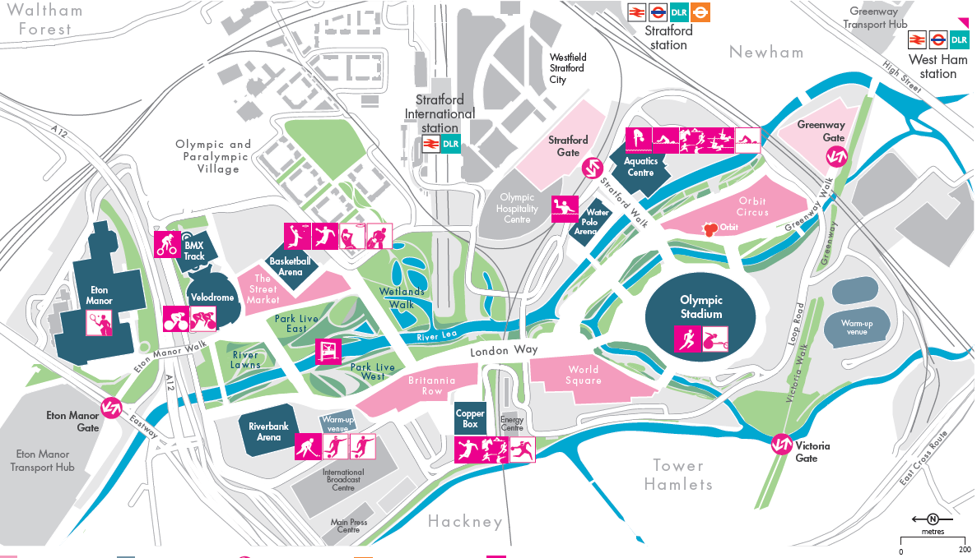

Slide 12
Map Reading
How far is the Olympic Stadium from the Aquatics center?
How far do you have to walk from Stratford International station to the Copper Box for the Handball event?
What is the perimeter of the Water Polo arena?
Which entrance is closer to the Olympic stadium; the Greenway gate of the Victoria gate and by how much?

